Slide 1

Impacts of Nutrition Change in the U.S
Source: USDA’s Agricultural Research Service and Food Data Central
Team 29 - United States Naval Academy
Emma Dear, Seungjae Hong, Matt Jao, Aaron Song

Slide 2
Agenda
02 The Questions
01 Background
03 Results and Analysis
04 Solutions

Slide 3
Introduction
Obesity is the leading cause of death in the United States
A Leading killer in America
Obesity is also linked to lower income and food insecurity
“Poverty-Obesity” Paradox
Given the FF and SR data, nutrient content in different food groups have changed over time
Food Analysis

Slide 4
01
The USDA, Food, and Income
Notes:
According to the USDA, poor nutrition is a leading cause of illness in the United States, associated with more than half a million deaths per year. It is linked with increased risk of obesity, diabetes, and heart disease as well as broader impacts including higher health care costs and decreased productivity. The Beltsville Human Nutrition Research Center aims their research at at understanding the relationship between eating decisions coupled with insults (excess calories, viruses, bacteria, and environment pollutants) on the quality of life and overall health as a function of age, gender, and ethnicity for U.S. citizens.
Source:
https://www.usda.gov/nutrition-security
https://www.ars.usda.gov/northeast-area/beltsville-md-bhnrc/beltsville-human-nutrition-research-center/

Slide 5
United States Department of Agriculture
Poor Nutrition is a leading cause of illness in the United States
Poor nutrition is leading to higher rates of obesity in the United States
Ensure healthier, more prosperous future for ALL Americans
Nutrition Security
The Problem
Goals

Slide 6
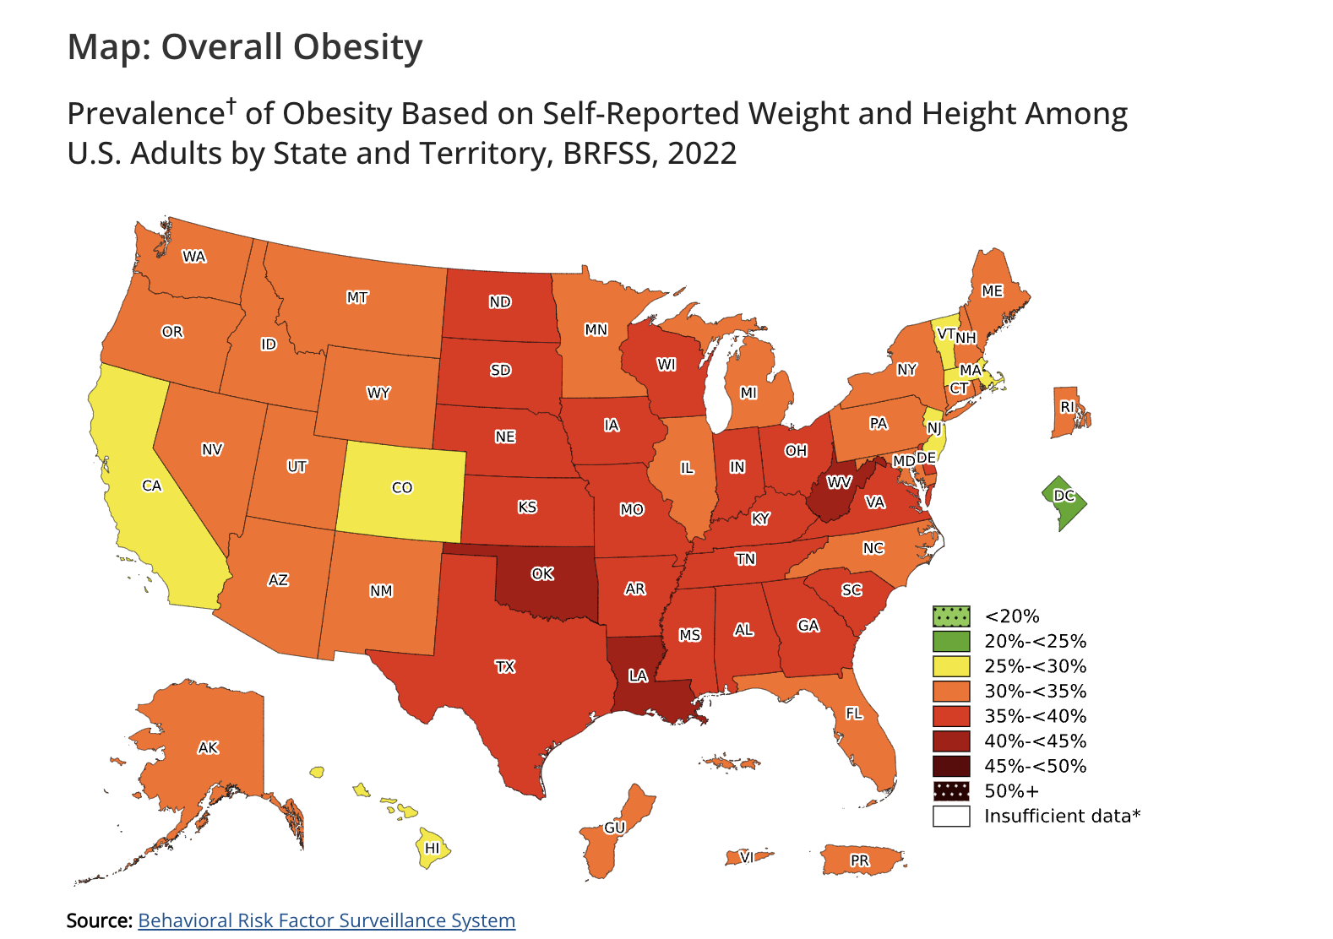
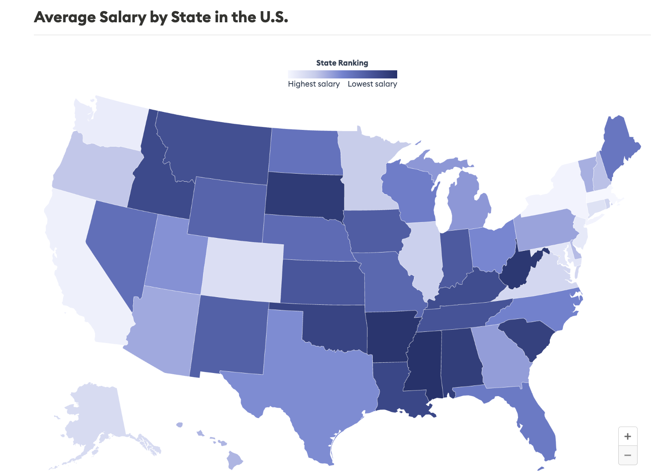
2024
Source: Bureau of Labor Statistics
Notes:
According to a study done by the CDC, the obesity prevalence rate has increased by 11.4% in the past 25 years from 30.5% to 41.9%. People with obesity are more prone to heart disease, stroke, and certain types of cancer which are among the leading causes of preventable, premature death. Additionally, the annual medical cost of obesity in 2019 was approximately $173 billion with medical costs for adults with obesity, on average, $1861 higher than medical costs for people with healthy weight. According to the map above on the left, we can point out people in rural communities have higher rates of obesity compared to those living in urban and suburban areas. As we can see from the graph on the right, there is a correlation between areas of low income and areas with high obesity prevalence. According to the National Institutes of Health, obese individuals have high rates of micronutrient deficiencies that play a key role in glucose metabolism and insulin signaling pathways. A large part of this is because of the increased availability of low-cost, high-calorie, nutrient-poor foods and modern agriculture and food processing techniques that lead to a reduction in micronutrient content of common foods. In the October 2009 version of Nutrition Reviews, a monthly medical journal published by Oxford University Press, a study pointed towards a deficiency in vitamin A, vitamin D, B-complex vitamins, calcium, iron, and zinc to be associated with obesity.
Sources:
https://www.cdc.gov/obesity/data/adult.html
https://www.cdc.gov/obesity/data/prevalence-maps.html
https://www.forbes.com/advisor/business/average-salary-by-state/
Olga P García, Kurt Z Long, Jorge L Rosado, Impact of micronutrient deficiencies on obesity, Nutrition Reviews, Volume 67, Issue 10, 1 October 2009, Pages 559–572,
https://doi.org/10.1111/j.1753-4887.2009.00228.x

Slide 7
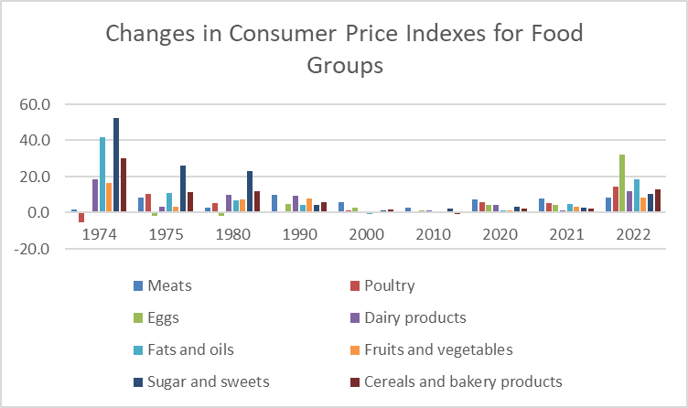
Changes In Food Prices
60%
Meticulous
100%
Proactive
Jupiter is a gas giant and the biggest planet in the Solar System
Mercury is the closest planet to the Sun and the smallest one
Notes:
Since 2000, America has seen a steady increase in food price. However, the dramatic inflation in food price from 2021-2022 was largely due to COVID-19, the war in Ukraine, and other challenges. Food prices generally increased about 11% from 2021-2022. During this time period, fruits and vegetables increased about 9%, dairy products increased 12%, meats, poultry, and fish increased about 12%, and grains increased by 13%. These dramatic changes could explain why people may turn to low-cost, low-nutrient foods, especially those living in lower income areas.
Sources:
https://www.gao.gov/blog/sticker-shock-grocery-store-inflation-wasnt-only-reason-food-prices-increased
Possible Sources:
https://www.medicalnewstoday.com/articles/obesity-and-poverty#is-poverty-linked-to-obesity
https://www.hsph.harvard.edu/obesity-prevention-source/obesity-prevention/food-environment/

Slide 8
03
Data Analysis

Slide 9
02 Guiding Questions
How does the FF and SR data change across the years for each food group?
Does a change in obesity-mitigating nutrients correlate with obesity rates in the U.S.?
Does lower income correlate with reduced availability of nutritionally dense foods?

Slide 10
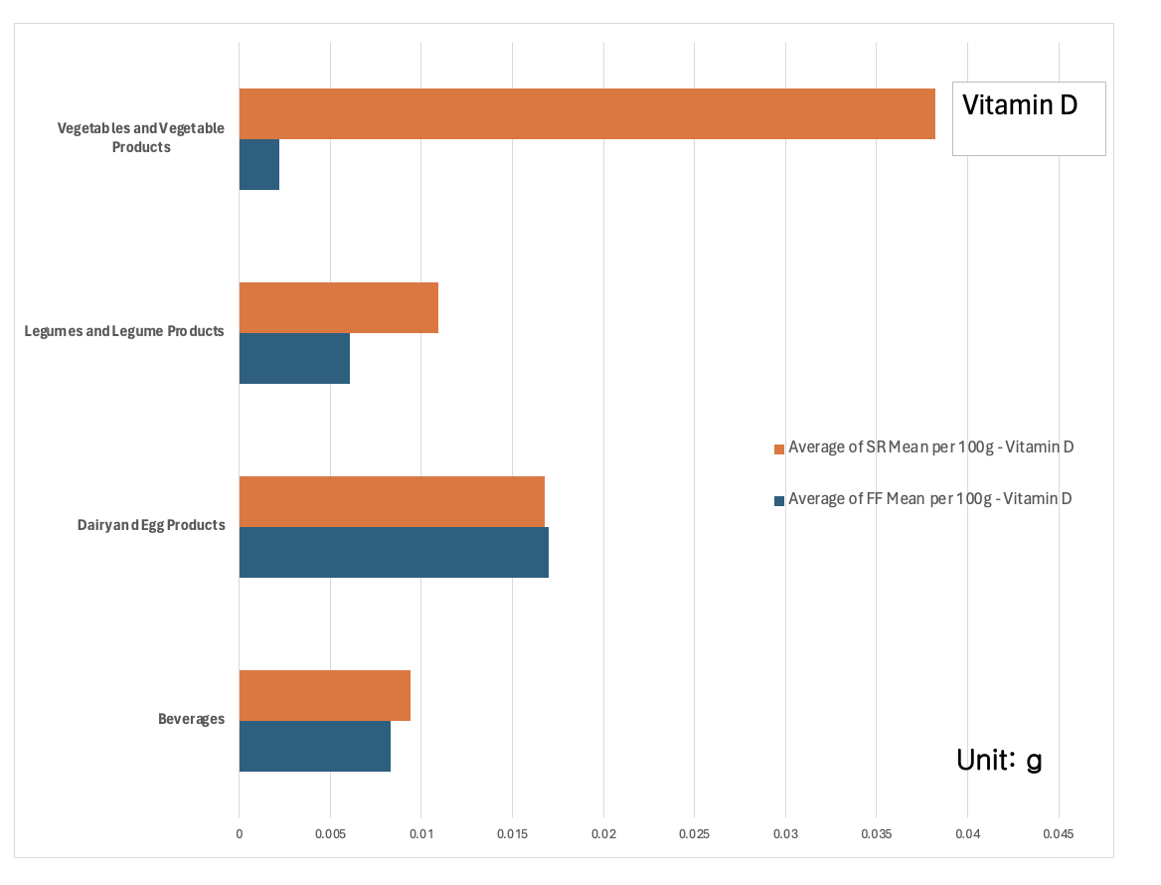

Slide 11
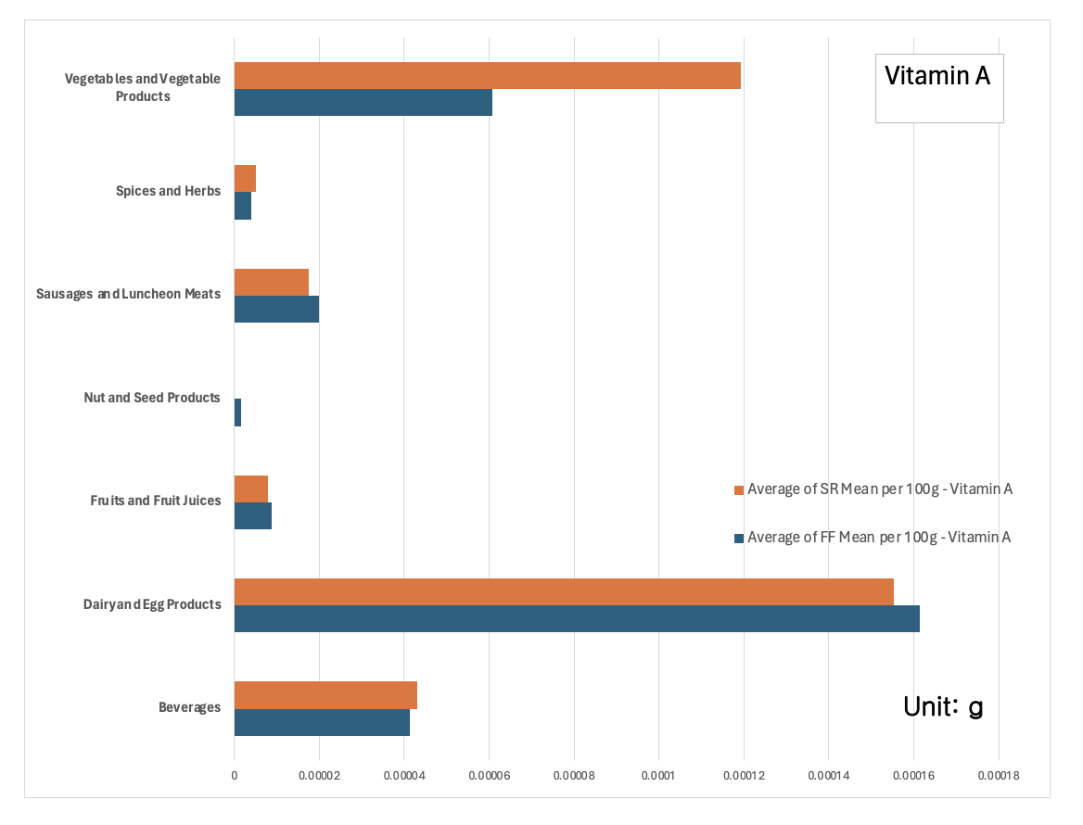

Slide 12
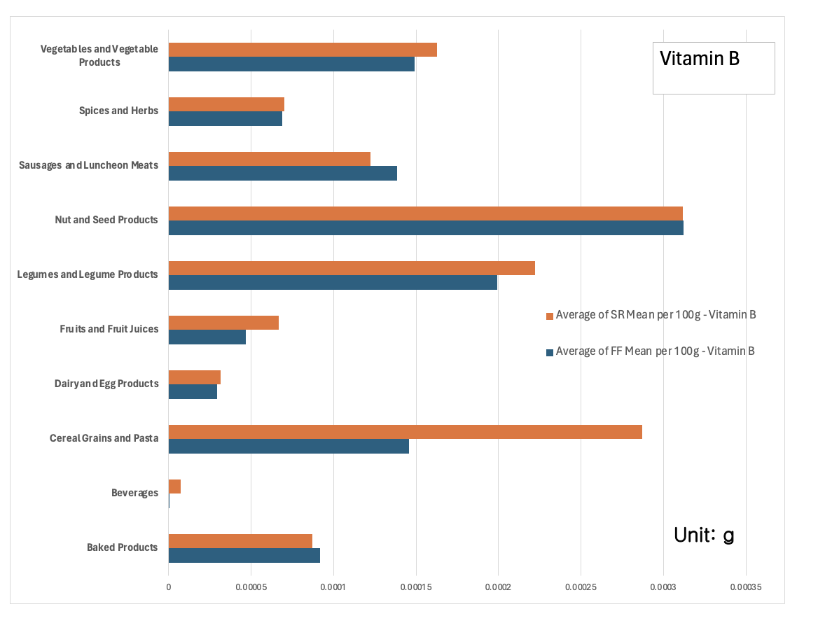

Slide 13
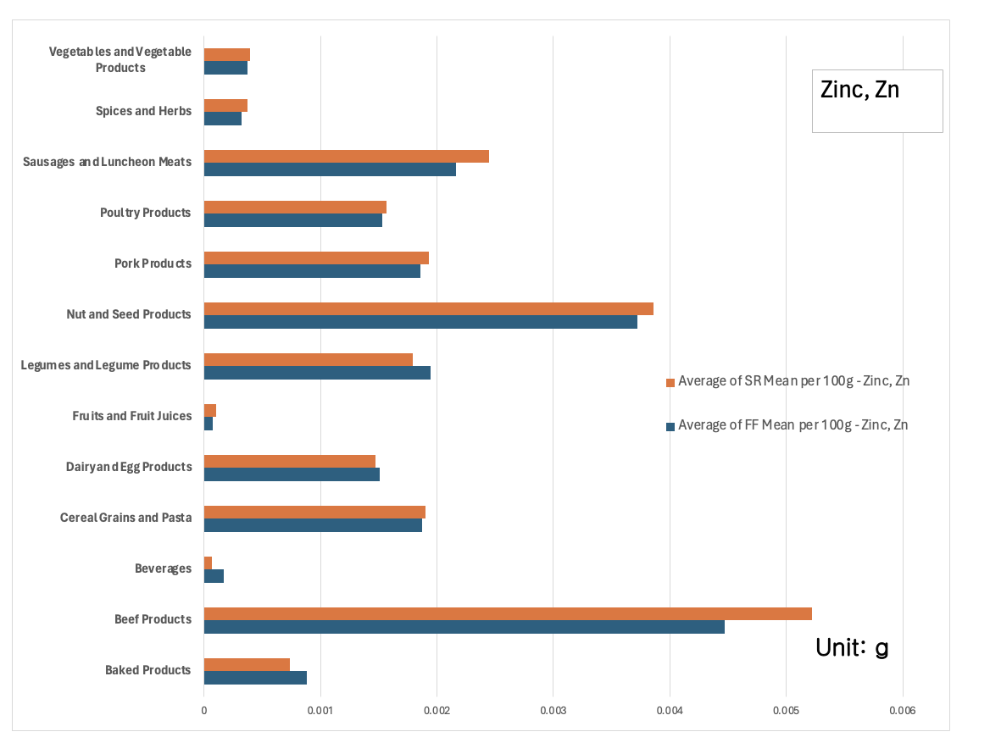
956,790
Big numbers catch your audience’s attention

Slide 14
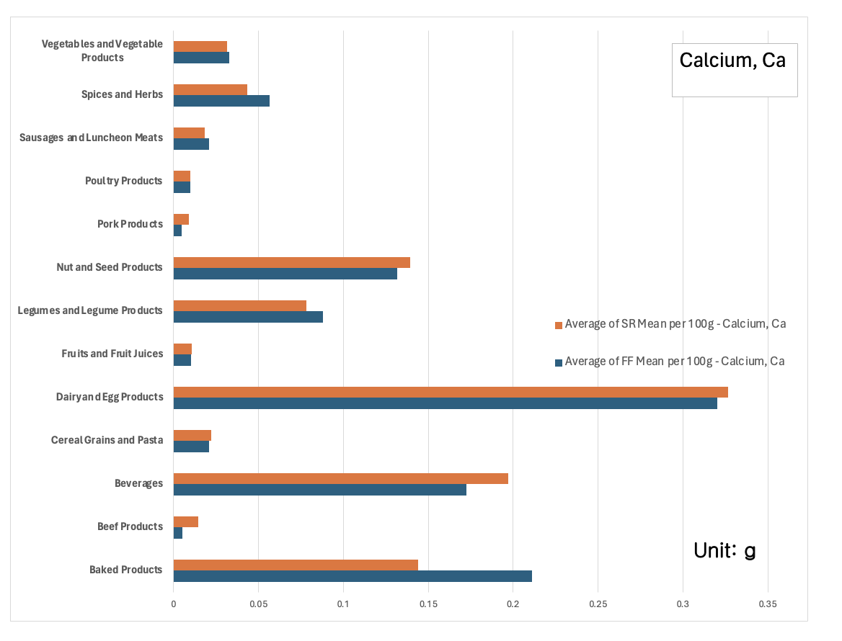

Slide 15
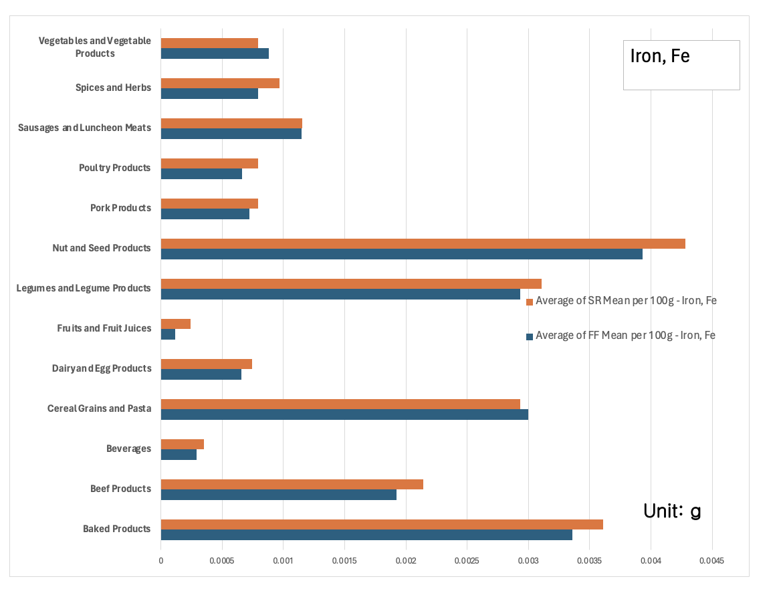
Notes:
On top of the poverty-obesity paradox, the evolving agricultural processes and methods used to farm have caused a decline in the quantity of nutrients in crops over the past decades. The use of genetically modified seeds, synthetic fertilizers, and pesticides have increased crop yields but ultimately disturb soil health and reduce the absorption of nutrients from the soil, causing common foods to have a lower nutrient content compared to the past.
Source:
https://www.nationalgeographic.co.uk/environment-and-conservation/2022/05/fruits-and-vegetables-are-less-nutritious-than-they-used-to-be

Slide 16
Analysis
The Data
Correlations
Nutrients
Significant changes between the SR and FF data
Decrease in obesity-mitigating nutrients correlate with an increase in obesity rates
Nutrient Content overall decreases from SR to FF data

Slide 17
04 Solutions
Monetary
Agricultural Practices
Reducing taxes on nutrient-dense, low-calorie foods or taxing high-calorie foods, i.e. sugary drink tax
Crop biofortification
Selective plant breeding
Limiting genetically modified seeds, pesticides, and synthetic fertilizers.

Slide 18
References
“Food and Nutrition Security,” U.S. Department of Agriculture, https://www.usda.gov/nutrition-security
“Beltsville Human Nutrition Research Center: Beltsville, MD,” U.S. Department of Agriculture Agricultural Research Service, https://www.ars.usda.gov/northeast-area/beltsville-md-bhnrc/beltsville-human-nutrition-research-center/
“Food price outlook,” U.S. Department of Agriculture Economic Research Service, https://www.ers.usda.gov/data-products/food-price-outlook/

Slide 19
Thank You!

